Slide 1
Assemblers
Presented by: Foram Thakor

Slide 2
Overview
Introduction
Elements of Assembly Language Programming
Design of the Assembler
Assembler Design Criteria
Two Pass Assembler
Single Pass Assembler

Slide 3
Assembler
Assembler is a program for converting instructions written in low-level assembly code into relocatable machine code and generating along information for the loader.
An assembler is a software tool that translates assembly language code into machine code, which is the binary instructions that a computer's central processing unit (CPU) can execute directly.
The process of converting assembly language to machine code is called assembly or assembling.
Self-assembler or Resident assembler is a program that runs on a computer and produces the machine codes for the same computer or same machine.
A cross-assembler is an assembler that runs on a computer and produces machine codes for other computers.

Slide 4
Basic Functions of Assembler
Translation: Converts assembly language code into machine code (binary instructions) that the CPU can execute directly.
Syntax Checking: Validates the syntax of the assembly code and reports errors.
Symbol Table Management: Keeps track of labels and variables, including their memory addresses.
Address Calculation: Determines the memory addresses for instructions and data.
Directive Processing: Handles assembler directives that guide the assembly process.
Output Generation: Produces an object file containing the machine code and additional linking information.

Slide 5
Types of Assemblers
Single-Pass Assembler:
Processes the assembly code in one pass and Simultaneously builds the symbol table and translates instructions to machine code.
Faster but less flexible, as forward references (labels used before they are defined) can be challenging to handle.
2. Multi-Pass Assembler:
Makes multiple passes over the source code.
Each pass refines the information and resolves more complex dependencies.
Used for complex assembly languages or when advanced optimizations are needed.

Slide 6
Assembly Language
Assembly language is a low-level programming language that provides a symbolic representation of a computer’s machine code.
It is closely tied to the architecture of the CPU and is used to write programs that interact directly with hardware.
It uses mnemonics to represent the operations that a processor has to do.
Which is an intermediate language between high-level languages like C++ and the binary language.
It uses hexadecimal and binary values, and it is readable by humans.

Slide 7
Elements of Assembly Language Programming
It provides 3 basic facilities which simplify programming:
Mnemonic Operation Codes
These are symbolic names or abbreviations for machine instructions. Mnemonics represent the operations that the CPU will execute.
Mnemonic codes are easier to remember than numeric codes.
Symbolic Operand
Data Declaration

Slide 8
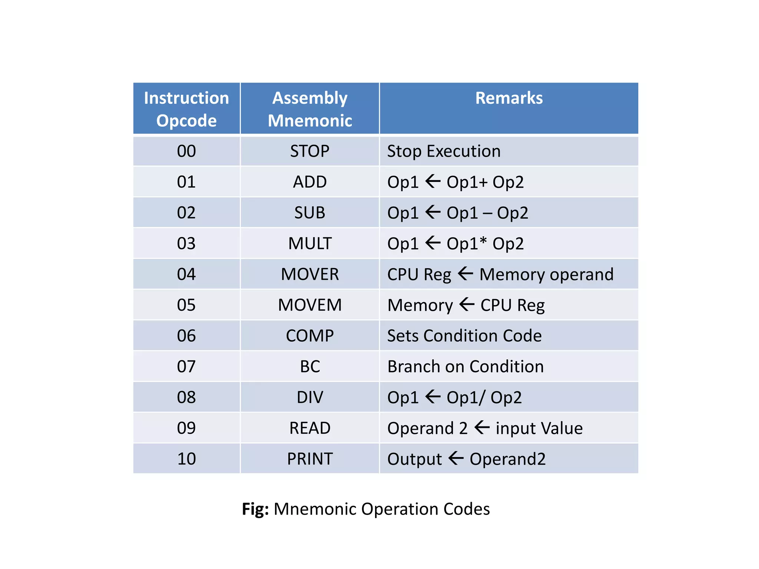
Mnemonic Opcode Table (OPTAB)

Slide 9
Elements of Assembly Language Programming
2. Symbolic Operand
These are the values or addresses that the mnemonics operate on.
Operands can be immediate values, registers, or memory locations.
For example, in the instruction MOV AX, 5,
MOV is a mnemonic opcode.
AX is a register operand in symbolic form.
5 is an immediate value.

Slide 10
Elements of Assembly Language Programming
3. Data Declaration
These guide the assembler on how to process the program.
Data declarations are a specific type of directive statement.
They are used to allocate memory for variables and constants and to define the type and size of data.
Data can be declared in various notations.

Slide 11
Various Data Declaration Notations
Hexadecimal Notation
(Base: 16, Digits: 0-9, A-F, Example: 0x1A3F (6719 in decimal))
Binary Notation
(Base: 2, Digits: 0, 1, Example: %1010 or 1010B (10 in decimal))
Octal Notation
(Base: 8, Digits: 0-7, Example: 0123 (83 in decimal))
Decimal Notation
(Base: 10, Digits: 0-9, Example: 123)
ASCII Notation (Represents characters by their ASCII values.)

Slide 12
Assembly Language Statements
[Label] <Opcode> <operand spec> [<operand spec>..]
It consists of three types of statements:
Imperative / Instruction Statement
Perform operations such as data movement, arithmetic, and control flow.
It indicates the action to be performed.
Each imperative statement translates into one machine instruction.
For example:
Data Movement: MOV AX, BX (moves data from BX to AX)
Arithmetic Operations: ADD AX, 5 (adds 5 to AX)
Control Flow: JMP LABEL (jumps to the instruction at LABEL)

Slide 13
Assembly Language Statements
2. Declarative Statements
Declare and initialize data or symbolic names.
[Label] DS <constant>
[Label] DC `<value>’
DS: Declare storage – reserves an area of memory and associates a symbolic name with it. (eg: A DS 1; B DS 200)
DC: Declare constant – it constructs memory words containing constants
The DC actually will not create constant. It initializes the memory with some value. (eg: C DC ‘10’, MOVER BREG, C)

Slide 14
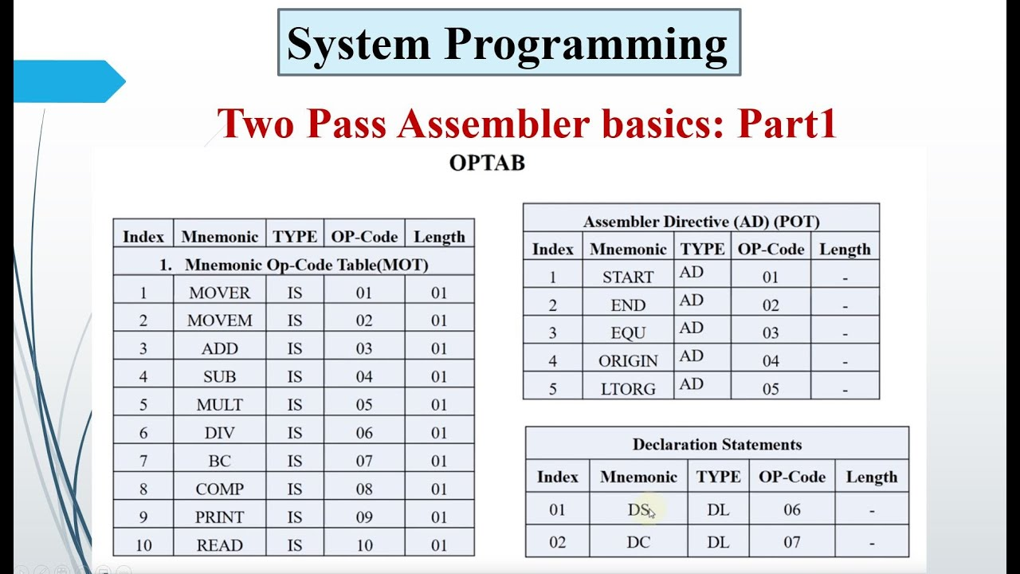
Data Declaration Table

Slide 15
Constants in Assembly Language
Two ways constant values can be used:
Using immediate operand in instruction
Use of immediate operand requires a special addressing mode.
For eg: ADDI AREG,10
Using literals
A literal is an operand with the syntax =’<value>’
Literal values used directly in instructions or data definitions.
For eg: ADD AREG, =’5’
Literal values used directly in instructions or data definitions.

Slide 16
Assembly Language Statement
3. Assembler Directives
Provide instructions to the assembler rather than the CPU.
They help manage data, memory, and code layout.
It instructs the assembler to perform certain actions while
assembling the program.
Two common directives: START and STOP
START <constant>
END [<Operand spec>]

Slide 17
Assembler Directives

Slide 18
Benefits of Assembly Language
High Performance: Provides efficient, optimized code with minimal overhead.
Fine-Grained Control: Offers detailed management of hardware and system resources.
Reduced Code Size: Produces compact, efficient programs.
Understanding Hardware: Helps learn and debug hardware-level operations.
System-Level Programming: Essential for OS, device drivers, and embedded systems.
Legacy Systems: Useful for maintaining and updating older code.
Custom Instructions: Accesses special processor instructions.
Real-Time Systems: Meets precise timing and control needs.

Slide 19
Design of the Assembler
The design of an assembler involves several key components and processes that transform assembly language code into machine code.
Assembler Design Flow:
Lexical Analyzer: Breaks assembly code into tokens (instructions, labels, operands).
Parser: Checks syntax and creates an intermediate representation.
Symbol Table Manager: Tracks labels and their addresses or values.
Code Generator: Converts intermediate representation into machine code.
Error Handler: Detects and reports syntax and semantic errors.

Slide 20
Design of the Assembler
Assembler phase:
First Pass
Purpose: Creates a preliminary symbol table and performs preliminary address calculations.
Function: Identifies labels and generates a preliminary machine code.
Second Pass
Purpose: Finalizes address calculations and generates the final machine code.
Function: Resolves addresses, updates the symbol table, and produces the final executable code.

Slide 21
Pass Structure of Assembler
A pass in a language processor performs language processing functions on every statement in a source program or in its equivalent representation.
A language processor may make multiple passes over a source program for handling forward reference and reduce memory requirement.
Multiple passes makes the language processor slower, so the design should include only fewer passes.

Slide 22
Assembler Design Criteria
When designing an assembler, several key criteria must be considered to ensure its effectiveness and efficiency. Here are the primary assembler design criteria:
Correctness: Accurately translates code to machine language.
Efficiency: Processes quickly and uses resources well.
Simplicity: Easy to understand and manage.
Flexibility: Supports various features and instructions.
Maintainability: Easy to update and modify.
Error Handling: Identifies and reports errors effectively.
Compatibility: Works with the target machine architecture.
Optimization: Generates efficient machine code.
User Interface: User-friendly for input and output.
Documentation: Provides clear and comprehensive guides.

Slide 23
Two - Pass Assembler
A two-pass assembler is a type of assembler that processes the source code in two distinct stages or passes to produce machine code.
This approach is used to handle complex assembly languages and ensure accurate address resolution.
Pass 1 – Analysis of source program
Pass 2 – Synthesis of target program
Handles Forward references easily.

Slide 24
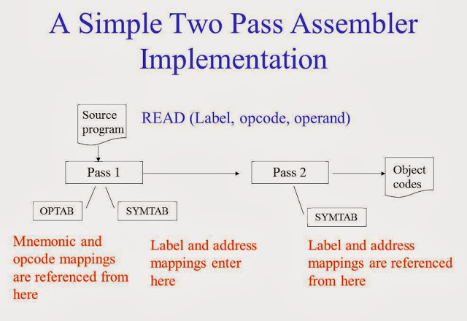
Two Pass Assembler

Slide 25
Pass-1 (Two Pass Assembler)
The first pass constructs intermediate code from the source program which is used by second pass.
The first pass focuses on creating a symbol table, which maps symbolic names (like labels) to memory addresses, and assigning addresses to each instruction and data definition.
Constructs a symbol table and assigns addresses to labels and instructions, generating intermediate code with placeholders.

Slide 26
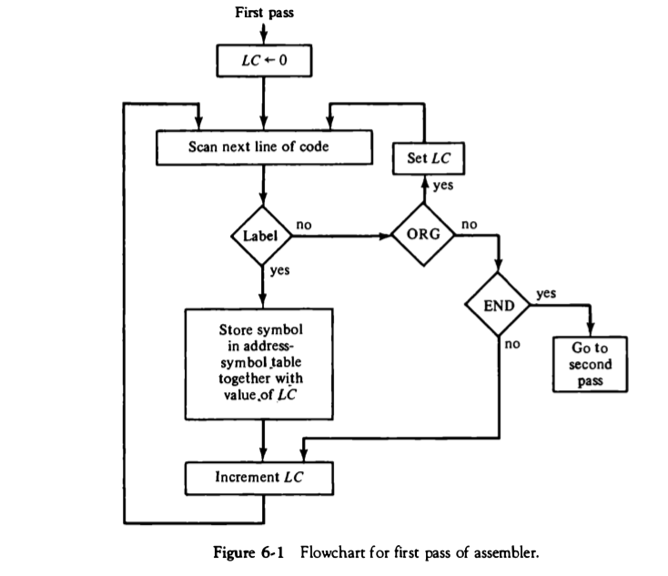

Slide 27
Pass-1 (Two Pass Assembler) Contd.
The steps performed by first pass is as follows:
Initialize Location Counter
The location counter starts at the address where the code or data is to be loaded into memory.
The assembler increments the LC as it processes each line of the assembly code.
Scan the Source Code
The assembler reads the assembly language code line by line.
For each line, it identifies and processes labels, instructions, and assembler directives.

Slide 28
Pass-1 (Two Pass Assembler) Contd.
3. Label Handling
If a label is encountered, it is entered into the symbol table along with the current value of the location counter.
Example: If a line starts with LOOP:, the symbol LOOP is added to the symbol table with the current address.
4. Address Assignment
The location counter is updated based on the type of instruction or directive.
Instructions typically increment the location counter by the number of bytes they occupy.
Assembler directives (like DS, DC) also affect the location counter, depending on the amount of memory they reserve.

Slide 29
Pass-1 (Two Pass Assembler) Contd.
5. Handle Assembler Directives
Directives such as EQU, ORG, and END are processed, which may affect symbol definitions or control the assembler’s operation.
Example: ORG 1000 sets the location counter to 1000.
6. Generate Intermediate Code
The assembler generates an intermediate code where symbolic references (e.g., labels) are not yet resolved. This code serves as a placeholder until the second pass.
Example: An instruction like JMP LOOP might be stored as JMP ?, with the address to be filled in later.

Slide 30
Pass-1 (Two Pass Assembler) Contd.
7. End of First Pass
After processing all lines of the source code, the symbol table is complete, containing all labels and their assigned addresses.
Errors: The assembler may detect some errors at this stage, such as duplicate label definitions, but will defer address-related issues to Pass 2.

Slide 31
Pass-2 (Two Pass Assembler)
The second pass generates the final machine code by resolving all symbolic references using the symbol table created in the first pass.
The intermediate representation consists of two main components
A data structure representation called symbol table
Processed form of source program
The second pass creates the target program by using the address information found in the symbol table.

Slide 32
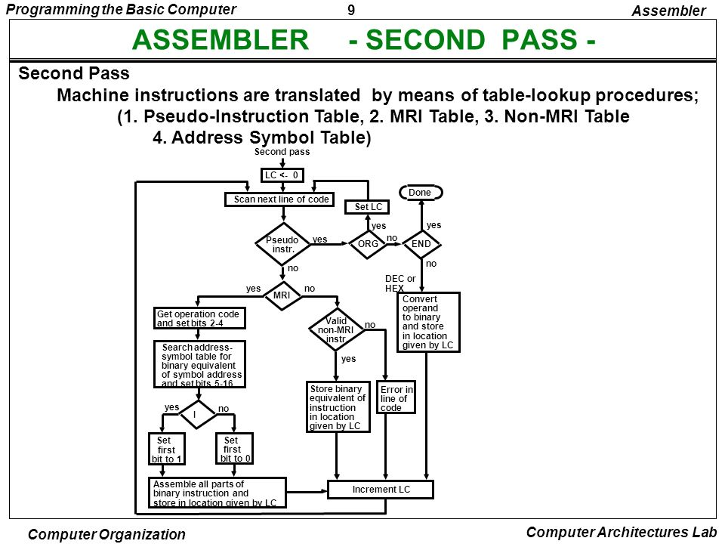

Slide 33
Pass-2 (Two Pass Assembler) Contd.
Steps followed by second pass are as follows:
Re-read the Source Code
The assembler reads the assembly language code again, using the symbol table from the first pass.
Address Resolution
As it encounters symbolic references (like labels), the assembler looks them up in the symbol table and replaces them with the actual memory addresses.
Example: If JMP LOOP is encountered, and LOOP was assigned address 1000 in the first pass, the instruction is now translated to JMP 1000.

Slide 34
Pass-2 (Two Pass Assembler) Contd.
3. Literal Handling
Literal Table Management: Literals (constants used directly in instructions) are assigned memory locations and stored in a literal table.
Memory Assignment: The assembler assigns memory addresses to literals, often at the end of the program, and updates instructions to reflect these addresses.
Example: A literal like =5 might be assigned memory at address 2000, so an instruction like LOAD R1, =5 is updated to LOAD R1, 2000.

Slide 35
Pass-2 (Two Pass Assembler) Contd.
4. Generate Machine Code
The assembler converts the assembly instructions into machine code, now that all operands, addresses, and instructions are fully resolved.
It replaces all placeholders in the intermediate code with the actual binary representations.
The assembler translates each assembly instruction into its corresponding machine code using the resolved addresses and literals.
Example: JMP LOOP, which was represented as JMP ? in the intermediate code, is now updated to JMP 1000 if LOOP is at address 1000.

Slide 36
Pass-2 (Two Pass Assembler) Contd.
5. Output Generation
Final Machine Code: The assembler produces the final machine code, ready to be loaded into memory for execution.
Object Code: In some cases, the assembler outputs an object file, which can be linked with other object files to create an executable.
Listing File: A listing file may also be generated, showing both the assembly code and the corresponding machine code, useful for debugging.

Slide 37
Pass-2 (Two Pass Assembler) Contd.
6. Error Handling
Address-Related Errors: The assembler checks for errors that could not be detected in Pass 1, such as undefined labels or out-of-range addresses.
Reporting: Any detected errors are reported to the programmer, along with the location and nature of the problem.
7. End of Second Pass
The assembly process is completed, and the final machine code is available for use.

Slide 38
Single Pass Assembler
A single-pass assembler is an assembly language translator that processes the source code in just one pass, meaning it reads and translates each instruction sequentially without revisiting any part of the code.
This approach differs from the two-pass assembler, which requires multiple scans of the source code.
In a single-pass assembler, both symbol table construction and machine code generation happen simultaneously as the assembler processes each line of code.

Slide 39
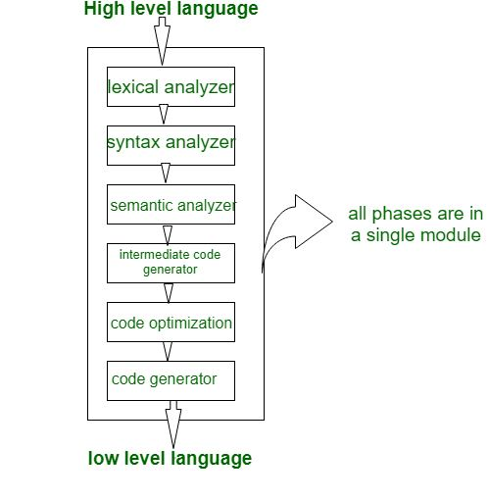

Slide 40
Single Pass Assembler Working
Steps in Single Pass Assembler are as follows:
Initialization
Location Counter (LC) Setup: The assembler initializes the location counter to the starting address (often 0 or as specified by an ORG directive).
Symbol Table Initialization: An empty symbol table is prepared to store labels and their corresponding addresses.
Line-by-Line Processing
As the assembler reads each line of the source code, it performs all necessary tasks in a single pass:
Instruction Identification: The assembler determines whether the line is an instruction, label, directive, or comment.

Slide 41
Single Pass Assembler Working (Contd.)
3. Symbol Definition and Address Assignment
Label Handling:
If a label is encountered, it is immediately added to the symbol table with the current value of the location counter as its address.
Instruction Translation:
The assembler translates the instruction into its corresponding machine code.
The machine code is generated on the spot, without the need for a second pass.
Location Counter Update:
After processing each instruction, the LC is incremented by the instruction size.

Slide 42
4. Forward Reference Handling
Forward reference refers to a situation in assembly language programming where an instruction or statement references a label, variable, or constant that is defined later in the code.
The assembler encounters this reference before it has been assigned a memory address, leading to a challenge in generating the correct machine code.
The problem of forward reference is tackled by backpatching.
In back patching the assembler leaves the operand field of an instruction blank if that instruction contains a forward reference to a symbol.

Slide 43
Backpatching
Backpatching is a technique used in assembly language programming, particularly in single-pass assemblers, to handle forward references.
A forward reference occurs when a label or symbol is used before it is defined.
Since the assembler processes the code in one pass and encounters these references before knowing their addresses, it cannot immediately resolve them.
Backpatching solves this by temporarily inserting placeholders and later "patching" these placeholders with the correct values once they are known.

Slide 44
Backpatching – Working
Encountering a Forward Reference
When the assembler comes across an instruction that references a label not yet defined (a forward reference), it cannot immediately generate the correct machine code.
Instead of halting, the assembler generates the machine code with a placeholder for the unresolved address.

Slide 45
Backpatching – Working (Contd.)
2. Creating and Managing TII
The assembler builds a table of incomplete instructions (TII) to record information about instructions whose operands fields were left blank.
Each entry in TII is of the pair (instruction address, symbol) to indicate that the address of the symbol should be put in the operand field of the instruction with address instruction address.
By the time the END statement is processed, the symbol table would contain the addresses of all symbols from source program and the TII would contain information describing all forward references.
The assembler now process each entry in TII to complete the concerned instruction

Slide 46
Single Pass Assembler Working (Contd.)
5. Error Handling
Immediate Error Detection:
The assembler checks for errors as it processes each line. Issues like undefined symbols at the time of use may lead to immediate error messages.
No Deferred Errors:
Since the assembler only makes one pass, errors need to be resolved immediately or through backpatching.

Slide 47
Single Pass Assembler Working (Contd.)
6. Output Generation
Machine Code: The assembler outputs the final machine code directly during this single pass.
Object Code: An object file may be produced, containing the assembled code ready for linking.
Listing File: Optionally, a listing file is generated, showing the source code alongside the generated machine code for debugging.

Slide 48
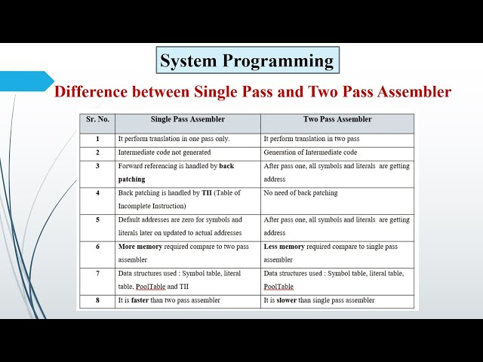
Difference b/w Single Pass and Two Pass assembler

Slide 49


